Slide 1
L. 2 Micropropagation technologies of plants.
What is Tissue Culture? Types,
Techniques and
Major Steps of Tissue Culture (Plants).
The application of plant tissue cultures
Process

Slide 2
Plant tissue culture
is a collection of techniques used to maintain or grow plant cells, tissues or organs under sterile conditions on a nutrient culture medium of known composition.
Plant tissue culture is widely used to produce clones of a plant in a method known as micropropagation.
Different techniques in plant tissue culture may offer certain advantages over traditional methods of propagation, including the following:

Slide 3
Plant tissue culture
The production of exact copies of plants that produce particularly good flowers, fruits, or have other desirable traits.
To quickly produce mature plants.
The production of multiples of plants in the absence of seeds or necessary pollinators to produce seeds.

Slide 4
The regeneration of whole plants from plant cells that have been genetically modified.
The production of plants in sterile containers that allows them to be moved with greatly reduced chances of transmitting diseases, pests, and pathogens.
The production of plants from seeds that otherwise have very low chances of germinating and growing, i.e.: orchids and Nepenthes.

Slide 5
To clear particular plants of viral and other infections and to quickly multiply these plants as 'cleaned stock' for horticulture and agriculture.
Plant tissue culture relies on the fact that many plant cells have the ability to regenerate a whole plant (totipotency).

Slide 6

What is Tissue Culture? Types, Techniques and Process
In biological research, tissue culture refers to a method in which fragments of a tissue (plant or animal tissue) are introduced into a new, artificial environment.
In artificial environment fragments of a tissue continue to function or grow.
While fragments of a tissue are often used, it is important to note that entire organs are also used for tissue culture purposes.

Slide 7
The application of plant tissue cultures
in fundamental and applied studies on various biological species is rapidly growing.
The use of in vitro technology for commercial propagation of plant species and for the production of bioactive components from them has become profitable industry worldwide.

Slide 8
A whole plant can be regenerated from a small tissue or plant cells in a suitable culture medium under controlled environment.
The plants so produced are called tissue-culture raised plants.
These plants are a true copy of the mother plant and show characteristics identical to the mother plant.
For example, if the mother plant is a high yielding plant the plants will also be high yielding.
Many plant species are presently being propagated through tissue culture successfully.

Slide 9
The capacity of a single cell to grow into a complete plant is termed as Totipotency,
Plant tissue culture can be initiated from almost any part of a plant however, for micropropagation or direct shoot regeneration, meristemetic tissue such as shoot tip is ideal.

Slide 10
The physiological state of the plant has an influence on its response to tissue culture.
The mother plant must be healthy and free from obvious signs of disease or pest.
The shoot tip explants being juvenile contain a higher proportion of actively dividing cells. It is important to use quality mother plant stock to initiate cultures.

Slide 11
Tissue culture is the in vitro aseptic culture of cells, tissues, organs or whole plant under controlled nutritional and environmental conditions often to produce the clones of plants.
The resultant clones are true-to type of the selected genotype.
The controlled conditions provide the culture an environment conducive for their growth and multiplication.

Slide 12
The controlled conditions in vitro include:
proper supply of nutrients,
pH medium,
adequate optimal temperature and
proper gaseous and liquid environment.

Slide 13
Types of Tissue Culture.
1. Seed Culture
Seed culture is the type of tissue culture that is primarily used for plants such as orchids.
For this method, explants (tissue from the plant) are obtained from an in-vitro derived plant and introduced in to an artificial environment, where they get to proliferate.
In the event that a plant material is used directly for this process, then it has to be sterilized to prevent tissue damage and ensure optimum regeneration.

Slide 14
2. Embryo Culture
Embryo culture is the type of tissue culture that involves the isolation of an embryo from a given organism for in vitro growth.
Note, the term embryo culture is used to refer to sexually produced zygotic embryo culture.
Embryo culture may involve the use of a mature of immature embryo. Whereas mature embryos for culture are essentially obtained from ripe seeds, immature embryo (embryo rescue) involves the use of immature embryos from unripe/hybrid seeds that failed to germinate. In doing so, the embryo is ultimately able to produce a viable plant.

Slide 15
2. Embryo Culture
For embryo culture, the ovule (яйцеклетка), seed or fruit from which the embryo is to be obtained is sterilized, and therefore the embryo does not have to be sterilized again.
Salt sucrose may be used to provide the embryo with nutrients.
The culture has to be enriched with organic or inorganic compounds, inorganic salts as well as growth regulators.

Slide 16
2. Embryo culture
is a type of plant tissue culture that is used to grow embryos from seeds and ovules in a nutrient medium.
In embryo culture, the plant develops directly from the embryo or indirectly through the formation of callus and then subsequent formation of shoots and roots.

Slide 17
2. Embryo culture
The technique of Embryo culture is developed to break seed dormancy, test the vitality of seeds, production of rare species and haploid plants.
It is an effective technique that is employed to shorten the breeding cycle of plants by growing excised embryos and results in the reduction of long dormancy period of seeds.

Slide 18
Use of Embryo Culture
Intra-varietal hybrids of an economically important energy plant “Jatropha” have been produced successfully with the specific objective of mass multiplication.
Somatic embryogenesis and plant regeneration has been carried out in embryo cultures of Jucara Palm for rapid cloning and improvement of selected individuals.

Slide 19
Use of Embryo Culture
In addition, conservation of endangered species can also be attained by practicing embryo culture technique. Recently a successful protocol has been developed for the in vitro propagation of Khaya grandifoliola by excising embryos from mature seeds.
The plant has a high economic value for timber wood (древесина) and for medicinal purposes as well.
This technique has an important application in forestry by offering a mean of propagation of elite individuals where the selection and improvement of natural population is difficult.

Slide 20
3. Callus Culture
Callus - This is the term used to refer to unspecialized, unorganized and a dividing mass of cells. A callus is produced when explants (cells) are cultured in an appropriate medium - A good example of this is the tumor tissue that grows out of the wounds of differentiated tissues/organs.
In practice, callus culture involves the growth of a callus (composed of differentiated and non- differentiated cells), which is the followed by a procedure that induces organ differentiation.

Slide 21
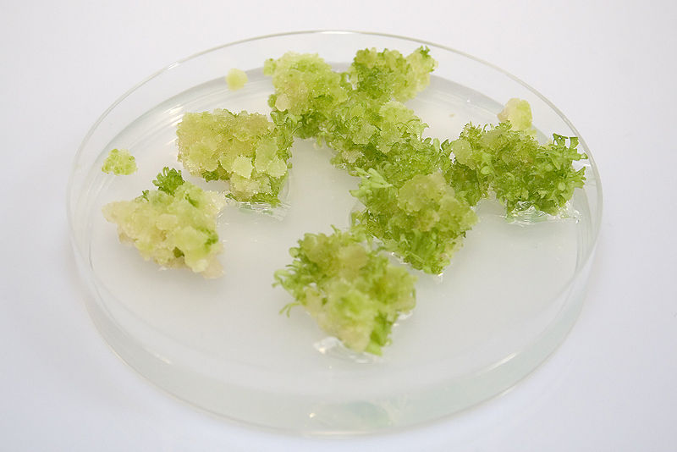
Callus Culture
For this type of tissue culture, the culture is often sustained on a gel medium, which is composed of agar and a mixture of given macro and micronutrients depending on the type of cells.
Different types of basal salt mixtures such as murashige and skoog medium are also used in addition to vitamins to enhance growth.

Slide 22
Organ Culture
Organ culture is a type of tissue culture that involves isolating an organ for in vitro growth.
Any organ plant can be used as an explant for the culture process (Shoot, root, leaf, and flower).

Slide 23
4. Organ Culture
With organ culture, or as is with their various tissue components, the method is used for preserve their structure or functions, which allows the organ to still resemble and retain the characteristics they would have in vivo.
New growth (differentiated structures) continues given that the organ retains its physiological features.
As such, an organ helps provide information on patterns of growth, differentiation as well as development.

Slide 24
There are number of methods that can be used for organ culture
These include;
Plasma clot method - The method involves the use of a clot that is composed of plasma and chick embryo extract (or any other extract) in a watch glass.
This method is particularly used for the purposes of studying morphogenesis in embryonic organ rudiments and more recently for studying the actions of various hormones, vitamins and carcinogens of adult mammalian tissues.

Slide 25
There are number of methods that can be used for organ culture. These include;
Raft method (Плотный метод) –
For this method, the explant is placed on a raft of lens paper/rayon acetate and floated on a serum in a watch glass.

Slide 26
Method of organ culture
Agar gel method –
The medium used for this method is composed of a salt solution, serum as well as the embryo extract or a mixture of various amino acids and vitamin with 1 percent agar.
The explant has to be subcultured every 5 to 7 days.
The method is largely used for the study of developmental aspects of normal organs and tumors.

Slide 27
Method of organ culture
Grid method –
Grid method, as the name suggests involves the use of perforated stainless steel sheet, on which the tissue of interest is placed before being placed in a culture chamber containing fluid medium.

Slide 28
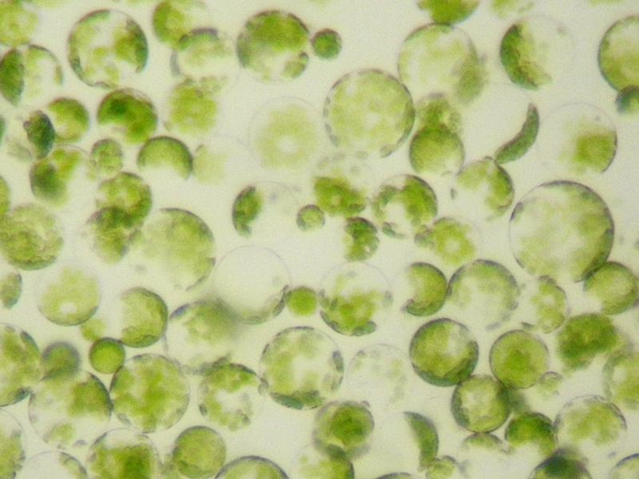
Protoplast Culture
Protoplast -cells without cell walls.
A protoplast is the term used to refer to cell (fungi, bacteria, plant cells etc) in which the cell wall has been removed, which is why they are also referred to as naked cells.

Slide 29
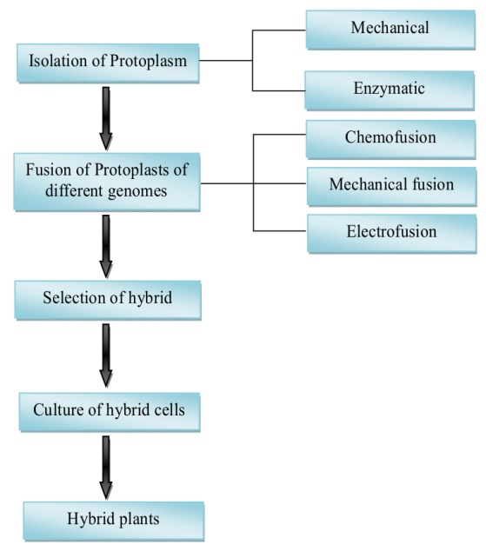
Protoplast Culture

Slide 30
Protoplasts may be cultured in the following ways:
Hanging-drop cultures
Micro culture chambers
Soft agars matrix
Once a protoplast has regenerated a cell wall, then it goes through the process of cell division to form a callus, which may then be subcultured for continued growth.

Slide 31
Protoplast culture is an important method that provides numerous cells (single cells) that can be used for various studies.
These include;
Protoplast culture regenerated into a whole plant
Development of hybrids
Cell cloning
Genetic transformations
Membrane studies

Slide 32
In protoplast culture, a number of phases can be observed.
These include;
Development of a cell wall
Cell division
Continuous growth or regeneration to a whole plant

Slide 33
For plants, some of the special requirements include in protoplast culture
Less amounts of iron and zinc and no ammonium
Higher concentration of calcium
High auxin/kinetic ratio for cell division and high kinetin/auxin ration for regeneration
Glucose and vitamins

Slide 34

Protoplast fusion (cлияние протопластов)
Somatic hybridization is an important tool of plant breeding and crop improvement by the production of interspecific and intergeneric hybrids.
The technique involves the fusion of protoplasts of two different genomes followed by the selection of desired somatic hybrid cells and regeneration of hybrid plants.
Protoplast fusion provides an efficient mean of gene transfer with desired trait from one species to another and has an increasing impact on crop improvement.
Somatic hybrids were produced by fusion of protoplasts from rice and ditch reed using electrofusion treatment for salt tolerance

Slide 35
In vitro fusion
of protoplast opens a way of developing unique hybrid plants by overcoming the barriers of sexual incompatibility. The technique has been applicable in horticultural industry to create new hybrids with increased fruit yield and better resistance to diseases. Successful viable hybrid plants were obtained when protoplasts from citrus were fused with other related citrinae species.

Slide 36
In vitro fusion
The potential of somatic hybridization in important crop plants is best illustrated by the production of intergeneric hybrid plants among the members of Brassicaceae.
To resolve the problem of loss of chromosomes and decreased regeneration capacity, successful protocol has been established for the production of somatic hybrid plants by using two types of wheat protoplast as recipient and protoplast of Haynaldiavillosa as a fusion donor.
It is also employed as an important gene source for wheat improvement.

Slide 37
Some of the other types of tissue culture include
Single cell culture
Suspension culture
Anther culture
Pollen culture
Somatic Embryogenesis

Slide 38
Major Steps of Tissue Culture (Plants)
Initiation Phase (Stage 1)
The initiation phase is the first phase of tissue culture. Here, the tissue of interest is obtained and introduced and sterilized in order to prevent any microorganism from negatively affecting the process. It is during this stage that the tissue is initiated in to culture

Slide 39
Multiplication Phase (Stage 2)
The multiplication phase is the second step of tissue culture where the in vitro plant material is re-divided and then introduced in to the medium.
The medium is composed of appropriate components for growth including regulators and nutrients.
These are responsible for the proliferation of the tissue and the production of multiple shoots.
*This step is often repeated several times in order to obtain the desired number of plants

Slide 40
Root formation (Stage 3)
It is at this phase that roots are formed.
Root formation hormones are required in order to induce rooting, and consequently complete plantlets

Slide 41
Plant Tissue Culture
Tissue culture is applied in plant research for such purposes as the growing of new plants, which in some cases undergo genetic alterations.
The plant of interest is taken through the tissue culture process and grown in a controlled environment.

Slide 42
The Process of Plant Tissue Culture
This process involves the use of small pieces of a given plant tissue (plant of interest). Once the tissue is obtained, it is then cultured in the appropriate medium under sterile conditions so as to prevent various types of microorganisms from affecting the process

Slide 43
The following is a general procedure for plant tissue culture
Medium preparation
The appropriate mixture (such as the MS mixture) is mixed with distilled water and stirred while adding the appropriate amount of sugar and sugar mixture. Here, sodium hydroxide or hydrochloric acid is used to adjust the pH - Contents used here will depend on the plant to be cultured and the number of tissues to be cultured.
Agar is added to the mixture, heat and stirred to dissolve
After cooling, the warm medium is poured into polycarbonate tubes (to a depth of about 4 cm)
With lids sitting on the tubes, the tubes are placed in a pressure cooker and sterilized for 20 minutes

